Slide 1
This week’s agenda
PID Controllers
  Structure of the PID Controller
  Proportional, Integral and Derivative Terms
  Setpoint Weighting
Process Models
  2 Parameter Models
  3 Parameter Models
  4 Parameter Models
  Comparison of Models
Parameter Tuning
Integrator Antiwindup
Performance Measures

Slide 2
PID Controllers
A very widely accepted industrial approach
Few parameters to tune
Physical meaning for each term
Low cost in manufacturing

Slide 3
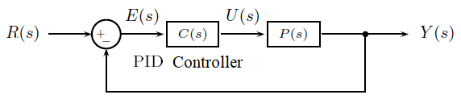
Structure of the PID Controllers
E(s): Input to PID controller, i.e. the error signal
U(s): Controller output, or control signal
R(s): Command signal
Y(s): Closed loop system response

Slide 4

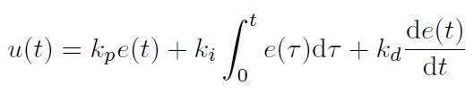
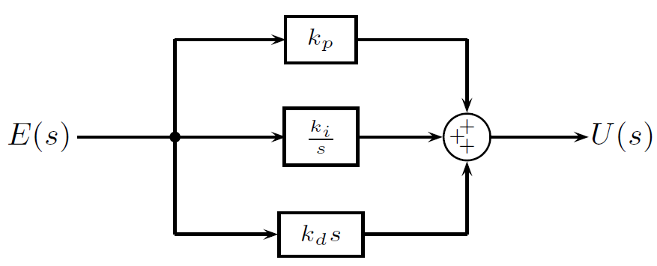
Structure of the PID Controllers
Parallel Form

Slide 5


Structure of the PID Controllers
Noninteracting Form

Slide 6
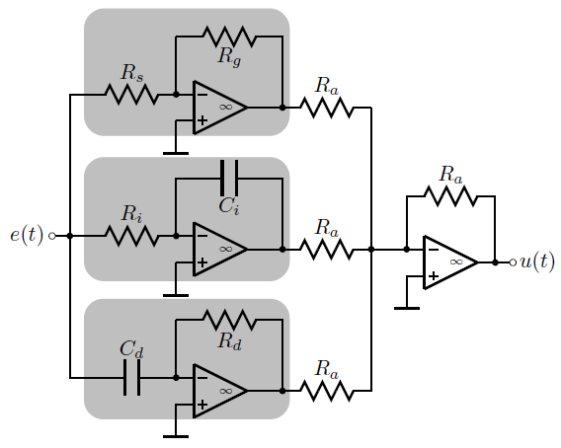

Structure of the PID Controllers
Circuit Realization of Parallel Form

Slide 7
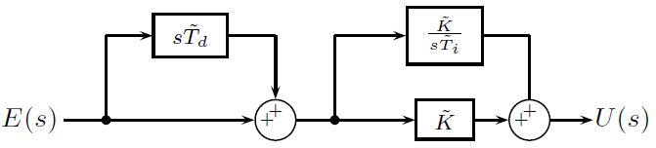


Structure of the PID Controllers
Interacting Form

Slide 8
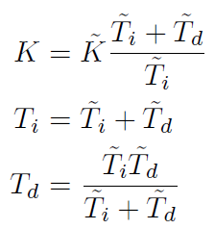
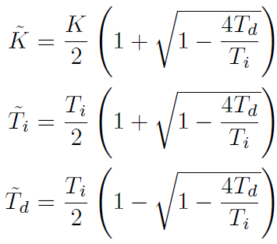

Relations Between the Parameters

Slide 9
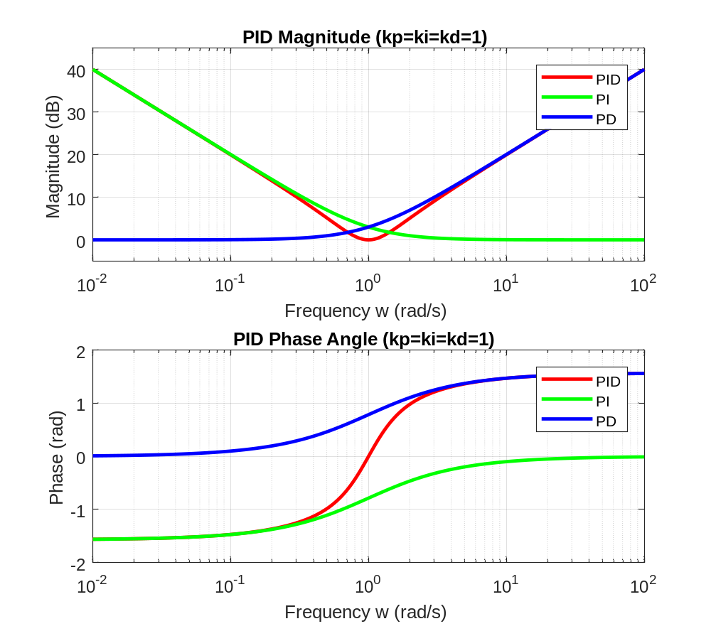

Slide 10

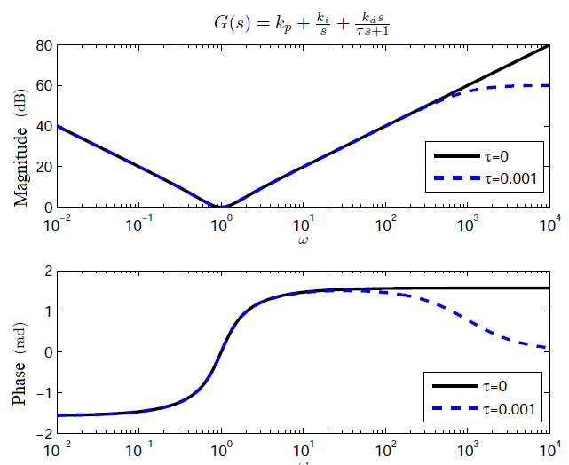
Finite Bandwidth Derivative Realization
k_{p}=k_{i}=k_{d}=1 and; τ=0 and τ=0.001

Slide 11



Variants of PID: P, PI, PD

Slide 12
A Simple MATLAB Code
kp=1;ki=1;kd=0.01;
P=tf(1,[1 1])
PIDcontroller=tf([kd kp ki],[1 0]);
ClosedLoopTF=feedback(P*PIDcontroller,1);
t=0:0.001:20;
step(ClosedLoopTF,t)

Slide 13
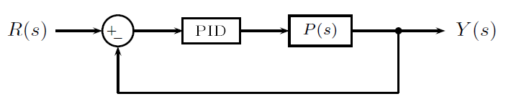
Setpoint Weighting
If the referernce signal changes suddenly
  k_{p}e(t) changes suddenly
  k_{d} de(t)/dt changes suddenly
Setpoint weighting approach aims at reducing the adverse effects of these sudden changes.

Slide 14
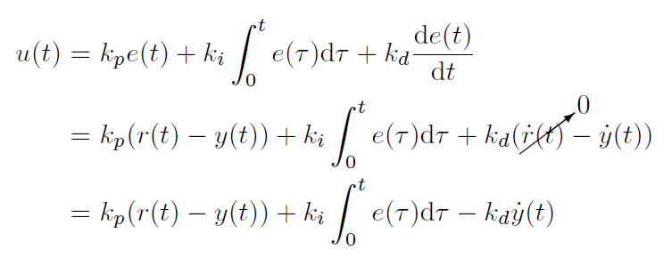
Setpoint Weighting
Constant
This approach prevents sudden jumps in the control signal

Slide 15





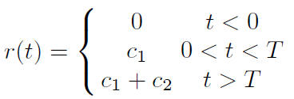
Setpoint Weighting

Slide 16



A Simple MATLAB Code

Slide 17


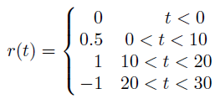
An Example
Compare the responses with α_{p}=0.5 and α_{d}=0 with the plain PID.

Slide 18
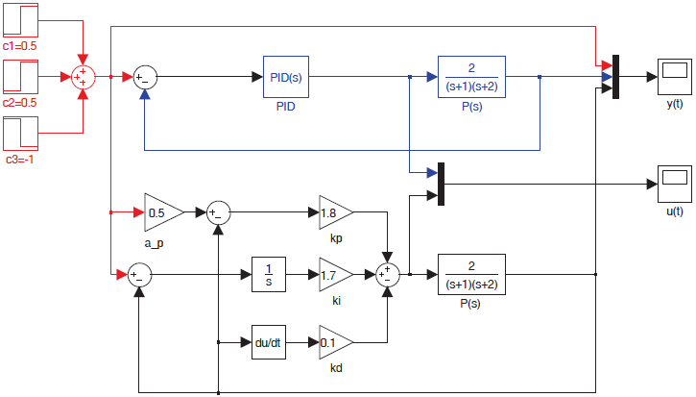
An Example

Slide 19
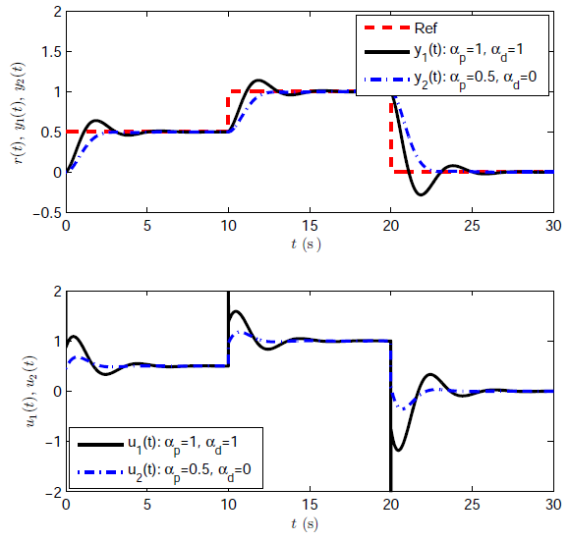
An Example

Slide 20

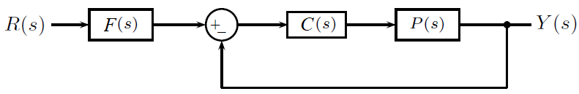
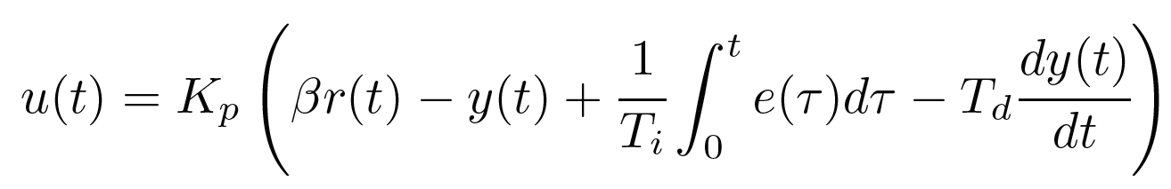
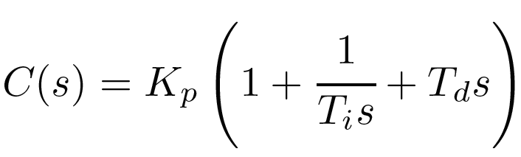
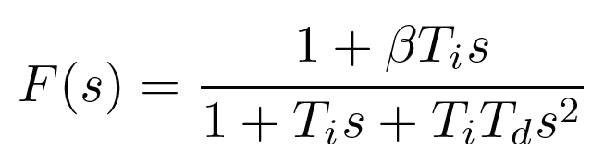
Setpoint Weighting
β < 1 reduces the overshoot.

Slide 21
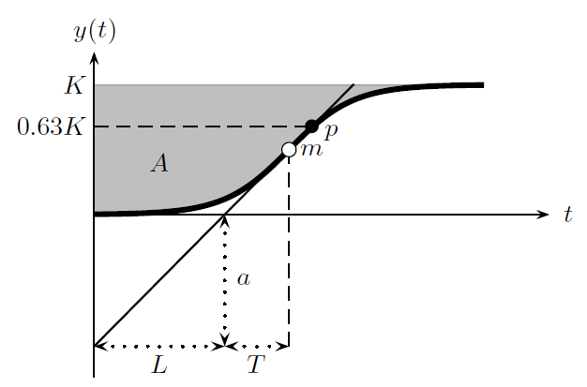
Process Models
We apply a step command to a system and obtain its response as shown below.

Slide 22
Process Models
Final value is K

Slide 23
Process Models
m is the point where the slope is maximum

Slide 24
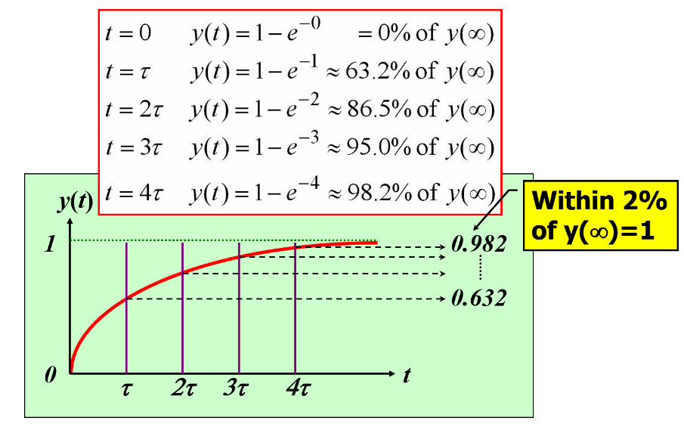
Process Models
p is the point where the output is at 0.63K (time constant)

Slide 25
Process Models
This line is tangent to the curve at point p. The parameters a, L and T are defined according to this line.

Slide 26

Process Models
A is an area defined as

Slide 27

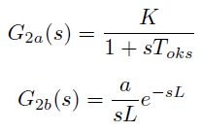
2 Parameter Models
Average residence time

Slide 28

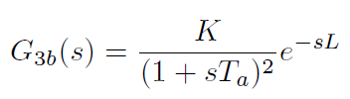

3 Parameter Models
Solve below equation for any time instant, find T_{a} and insert into model G_{3b}.

Slide 29
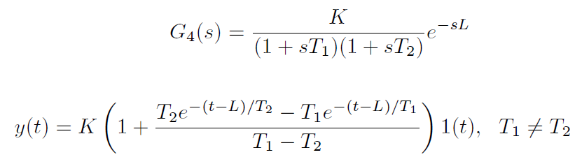
4 Parameter Models
To find T₁ and T₂, choose two points from the solution and solve the below solution of y(t).

Slide 30
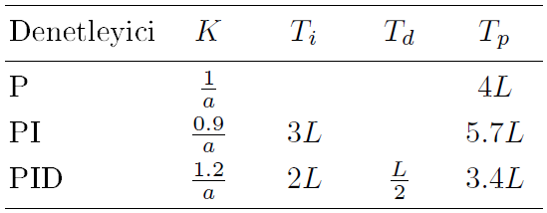
Parameter Tuning: Ziegler Nichols
Controller
T_{p}: Period of possible damped oscillations

Slide 31
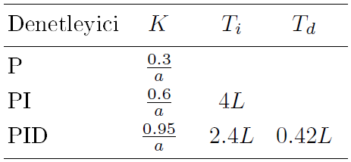
Parameter Tuning: Chein-Hrones-Reswick (No Overshoot)
Controller

Slide 32
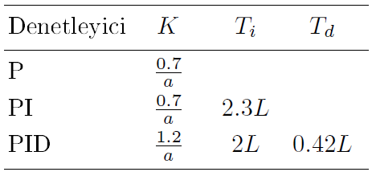
Parameter Tuning: Chein-Hrones-Reswick (20% Overshoot)
Controller

Slide 33
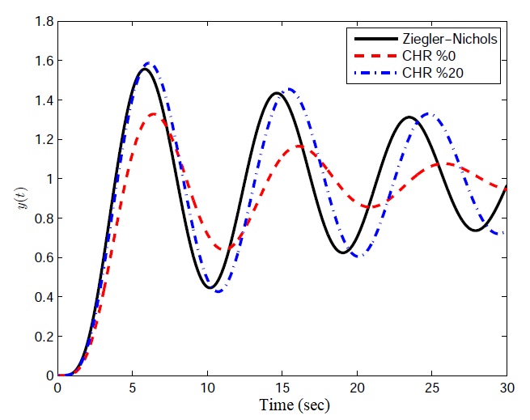

Example

Slide 34
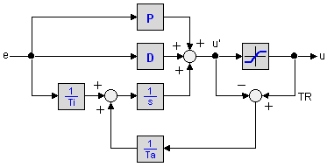
Integrator Antiwindup

Slide 35
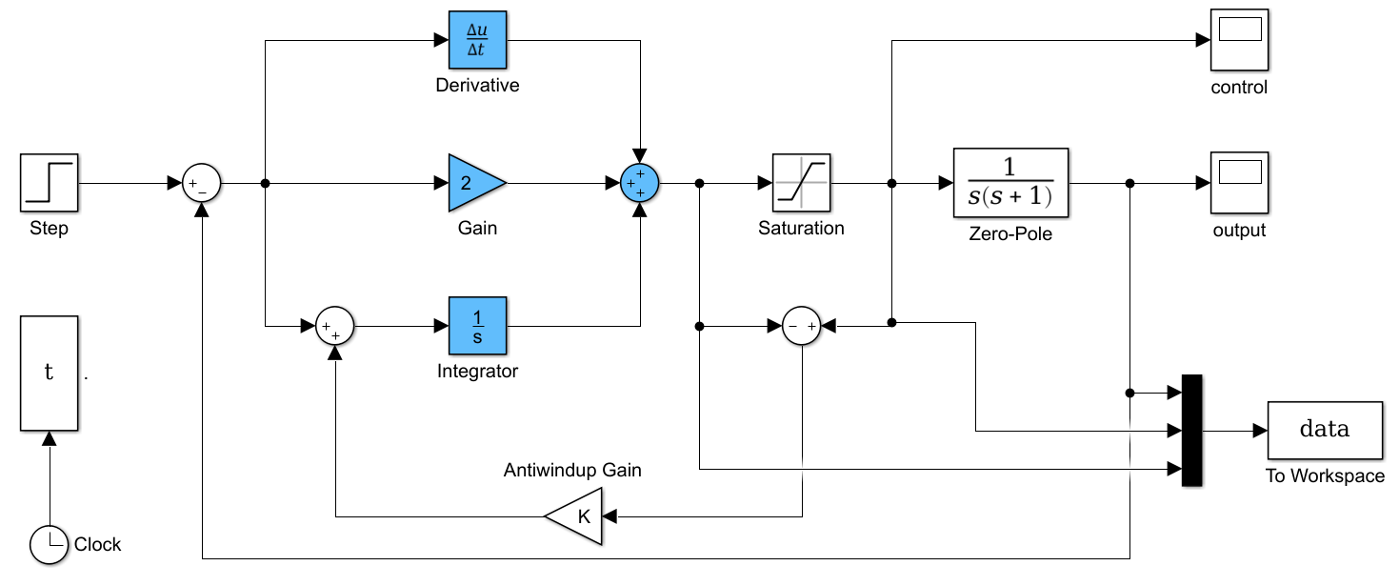
Integrator Antiwindup

Slide 36
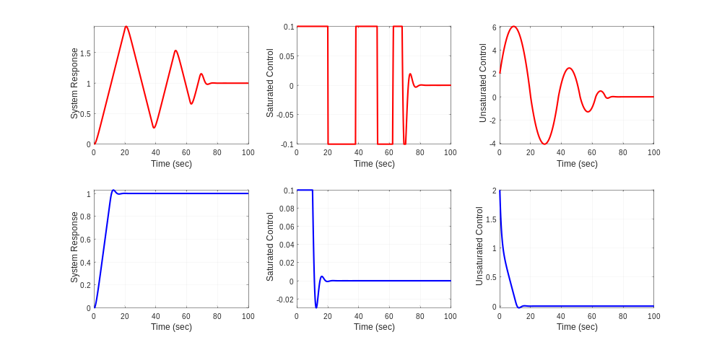
Integrator Antiwindup

Slide 37
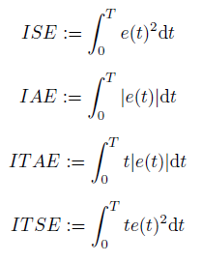
Performance Measures
Integral of the Squared Error
Integral of the Absolute value of Error
Integral of Time multiplied by Absolute Error
Integral of Time multiplied by Squared Error

Slide 38
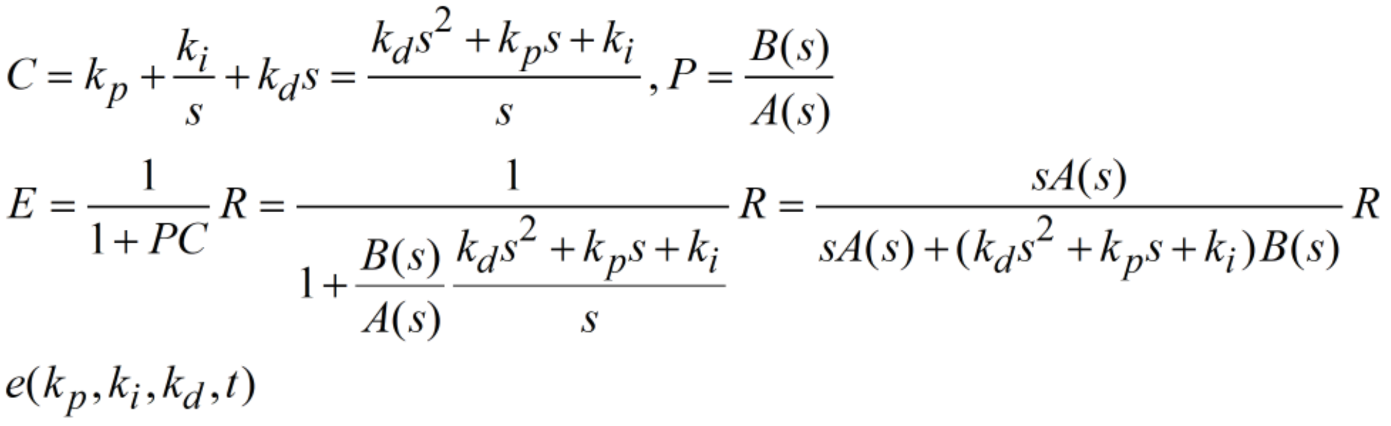
Performance Measures
E
needs to be computed and optimized to obtain minimum ISE, IAE, ITAE or ITSE.

Slide 39
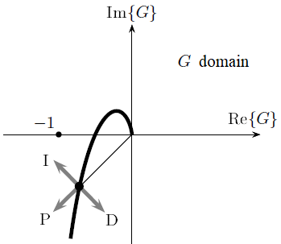
Effect of P, I and D Actions on Nyquist Plot

Slide 40
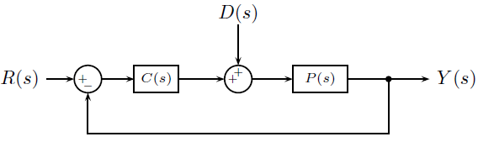
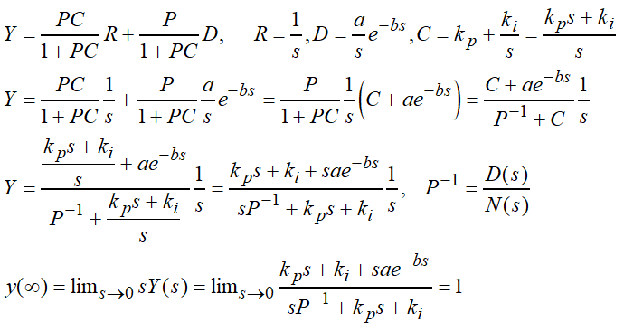
Disturbance Rejection

Slide 41
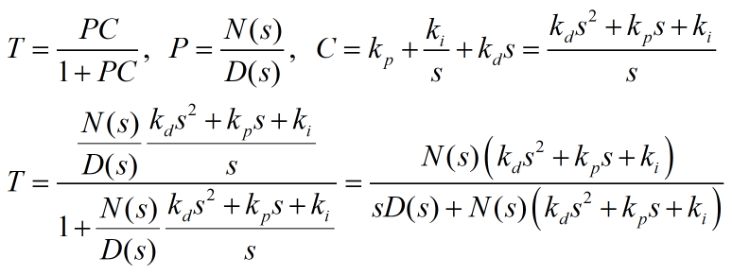
Stability with PID

Slide 42
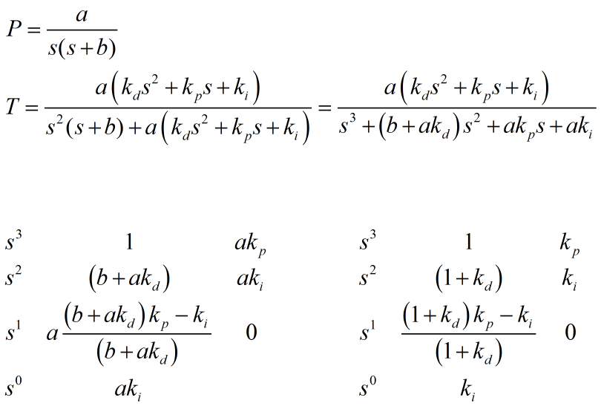
Stability with PID

Slide 43

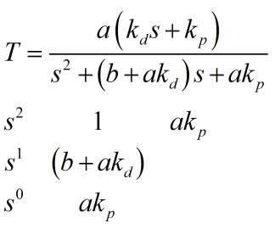
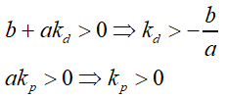
Stability with PD Case

